Slide 1
Unsupervised Machine Learning on a Hybrid Quantum Computer
Johannes Otterbach
Bay Area Quantum Computing Meetup - YCombinator
February 1 , 2018

Slide 2
Full Stack Quantum Computing
Quantum Processor
Hardware
Cloud based Quantum Operating System
Applications

Slide 3
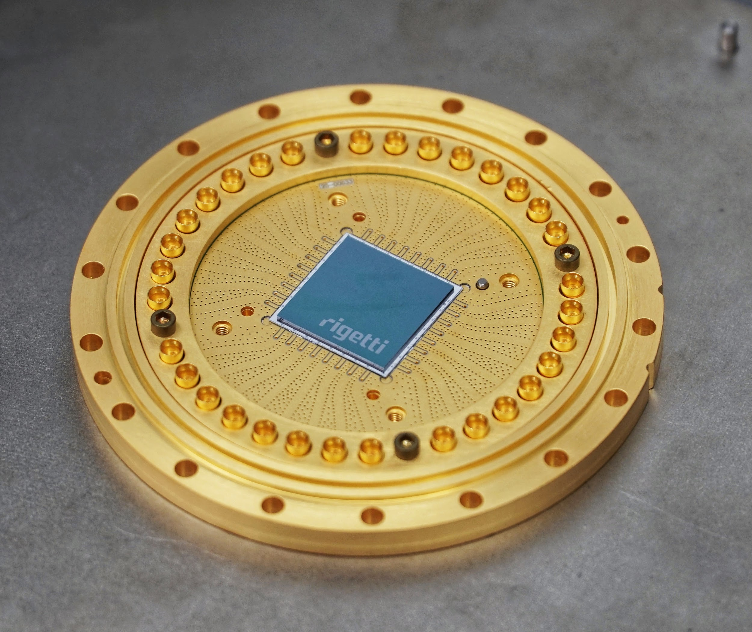
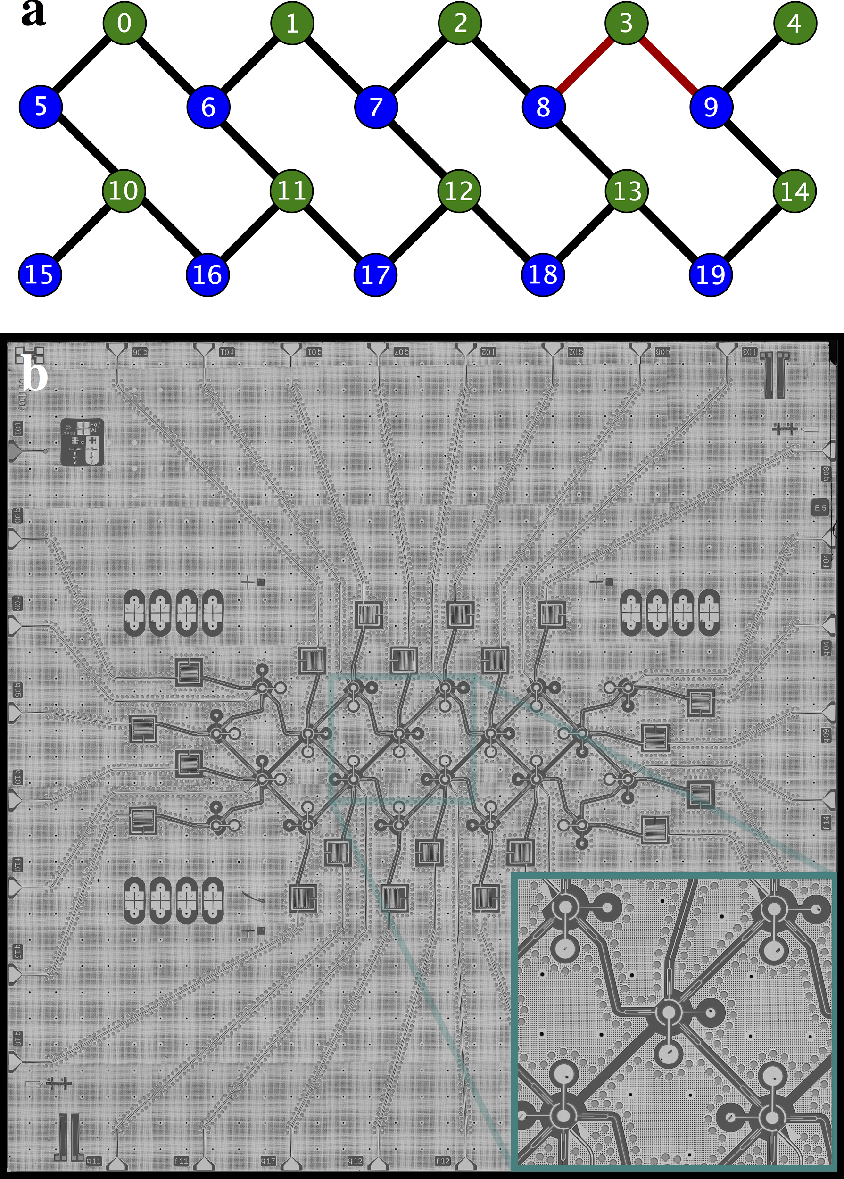
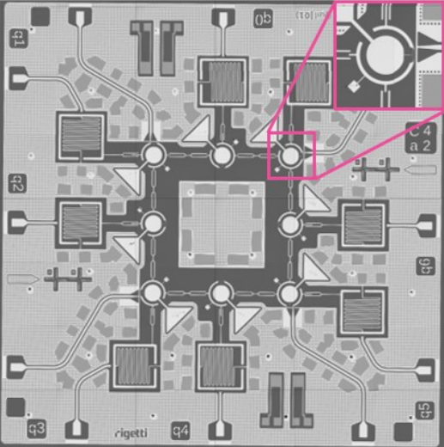
19Q-Acorn available now
pyquil.readthedocs.io
8Q June 2017
arXiv:1712.05771

Slide 4
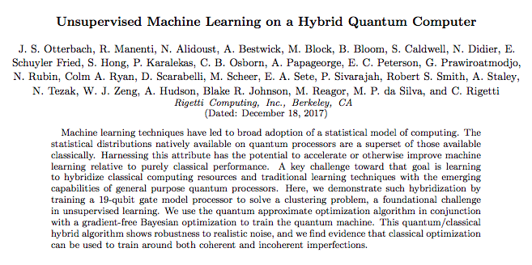
19Q-Acorn available now
pyquil.readthedocs.io
8Q June 2017
arXiv:1712.05771

Slide 5
Clustering
Given an unlabeled set of points

Slide 6
Clustering
Given an unlabeled set of points, find labels based upon similarity metric (e.g. Euclidean distance).

Slide 7
Clustering Example - Recommender Systems
Netflix Customers
Recommend action movies
Recommend RomComs
Watched the same movies

Slide 8
Clustering as MAXCUT
3
Construct a graph G=(V,E) where the edge weights w_{i,j} are determined by the distance metric. Then, MAXCUT is a clustering algorithm for the original points.
1
3
2
2
2
2
5
1
4
MAXCUT =

Slide 9
Clustering as MAXCUT
3
Construct a graph G=(V,E) where the edge weights w_{i,j} are determined by the distance metric. Then, MAXCUT is a clustering algorithm for the original points.
Clustering transformed into an optimization problem.
1
3
2
2
2
2
5
1
4
MAXCUT =

Slide 10
MAXCUT as Energy Functional
“Maximize disagreement on a colored graph”
Score 0
Score 0
Score+1
4-node “ring of disagrees”
Score 0
Score 2
Score 2
Score 4 (max)

Slide 11
MAXCUT as Energy Functional
“Maximize disagreement on a colored graph”
Score 0
Score 0
Score+1
4-node “ring of disagrees”
Binary variable
= 1
Score 0
Score 2
= 0
Score 2
Score 4 (max)

Slide 12
MAXCUT as Energy Functional
“Maximize disagreement on a colored graph”
Score 0
Score 0
Score+1
4-node “ring of disagrees”
Binary variable
= 1
Score 0
Score 2
= 0
Score 2
Score 4 (max)

Slide 13
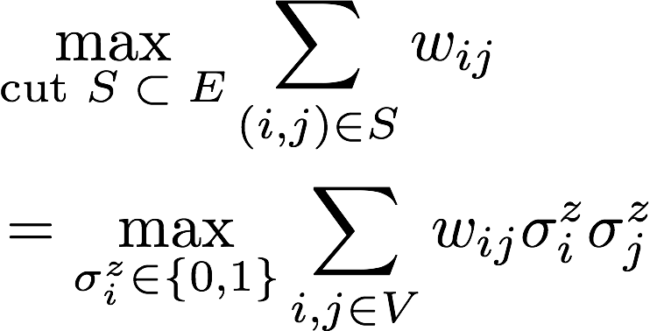
MAXCUT as Energy Functional
= 1
= 0
3
1
3
2
2
2
2
5
1
4

Slide 14
MAXCUT as Energy Functional
= 1
= 0
3
1
3
2
2
2
2
5
1
4
Find the right bit-string assignment that maximizes the energy

Slide 15
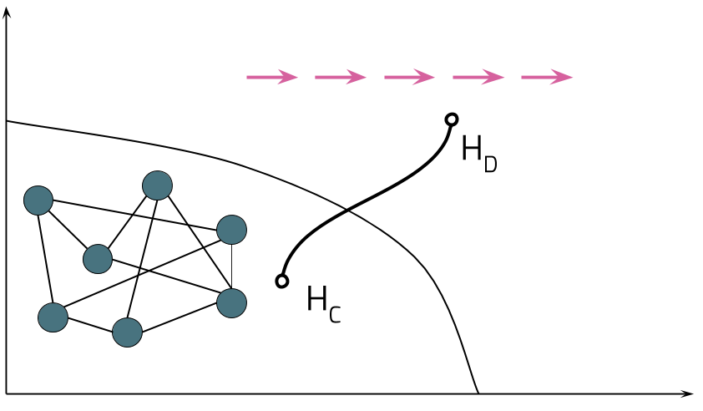
QAOA - Quantum Approximate Optimization Algorithm
IDEA
Start at easy to prepare initial state of energy functional H_{D}
“Cool” the system until it freezes in the low energy state of H_{C}

Slide 16
Discretize the Cooling Protocol
Gate model of Optimization (Farhi, Goldstone, Gutman, arxiv:1411.4028)
Angles β, ɣ need not be small
How to find optimal β, ɣ ?

Slide 17
Back to MAXCUT
Initial state is ground state of H_{D} :
Run the QAOA prescription:
Intuitively: Superposition of bitstring configurations
| β, ɣ〉
√p₁
√p₂
√p₁₆

Slide 18
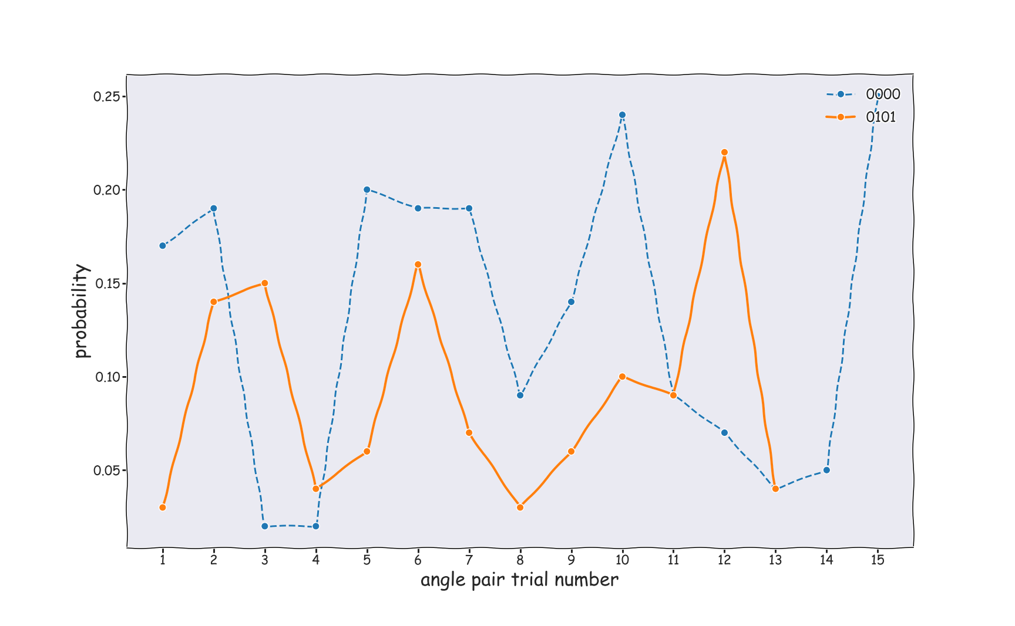
Effects of the different Angles
Angles change the probability to sample different bit strings

Slide 19
Effects of the different Angles
Angles change the probability to sample different bit strings Want to maximize the probability to sample the “correct” bitstring

Slide 20
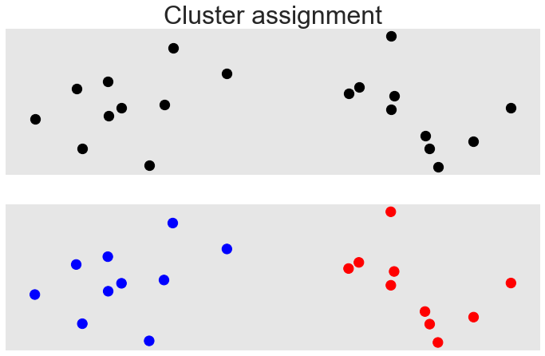
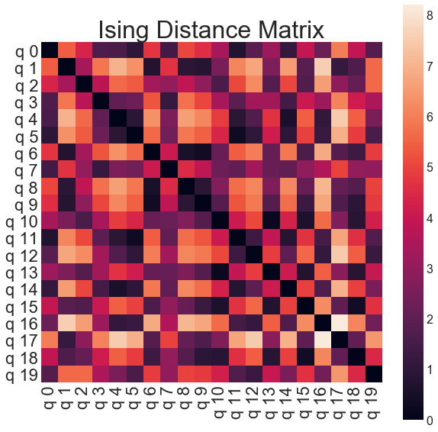
Clustering Procedure
Graph encoding
Hamiltonian
QAOA
Euclidean distance
Measurement in computational basis

Slide 21
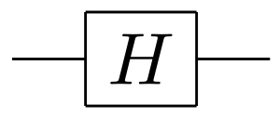
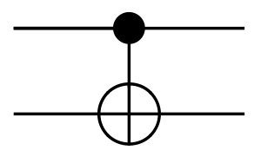
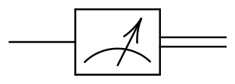
Forest - Quil
Quantum instructions
Quantum Instruction Language
X
H
Z
CNOT
MEASURE
X q
H q
Z q
CNOT p q
MEASURE q [0]
MEASURE p [1]
Z

Slide 22
Forest - pyQuil
QAOA
In 14 lines of code
from pyquil.quil import Program from pyquil.gates import H from pyquil.paulis import sI, sX, sZ, exponentiate_commuting_pauli_sum from pyquil.api import QVMConnection graph = [(0, 1), (1, 2), (2, 3)] nodes = range(4) init_state_prog = sum([H(i) for i in nodes], Program()) h_cost = -0.5 * sum(sI(nodes[0]) - sZ(i) * sZ(j) for i, j in graph) h_driver = -1. * sum(sX(i) for i in nodes) def qaoa_ansatz(betas, gammas): return sum([exponentiate_commuting_pauli_sum(h_cost)(g) + exponentiate_commuting_pauli_sum(h_driver)(b) \ for g, b in zip(gammas, betas)], Program()) program = init_state_prog + qaoa_ansatz([0., 0.5], [0.75, 1.]) qvm = QVMConnection() qvm.run_and_measure(program, qubits=nodes, trials=10)

Slide 23
When are we done?
CPU
QPU
Create Quil with selected parameters
Compile to hardware instructions
Entry
Select angles
Play instructions
Output
Evaluate termination criterion
Analyze Samples
& Evaluate real valued objective function
Measure
&
Record Sample

Slide 24
Objective Function
Loss/Reward Function:
“quality of a sampled bit-string”
Score 0
Score 0
Score+1
Find the optimal value of the Reward function:
No easy access to gradients, need derivative free methods
E.g. Bayesian Methods

Slide 25
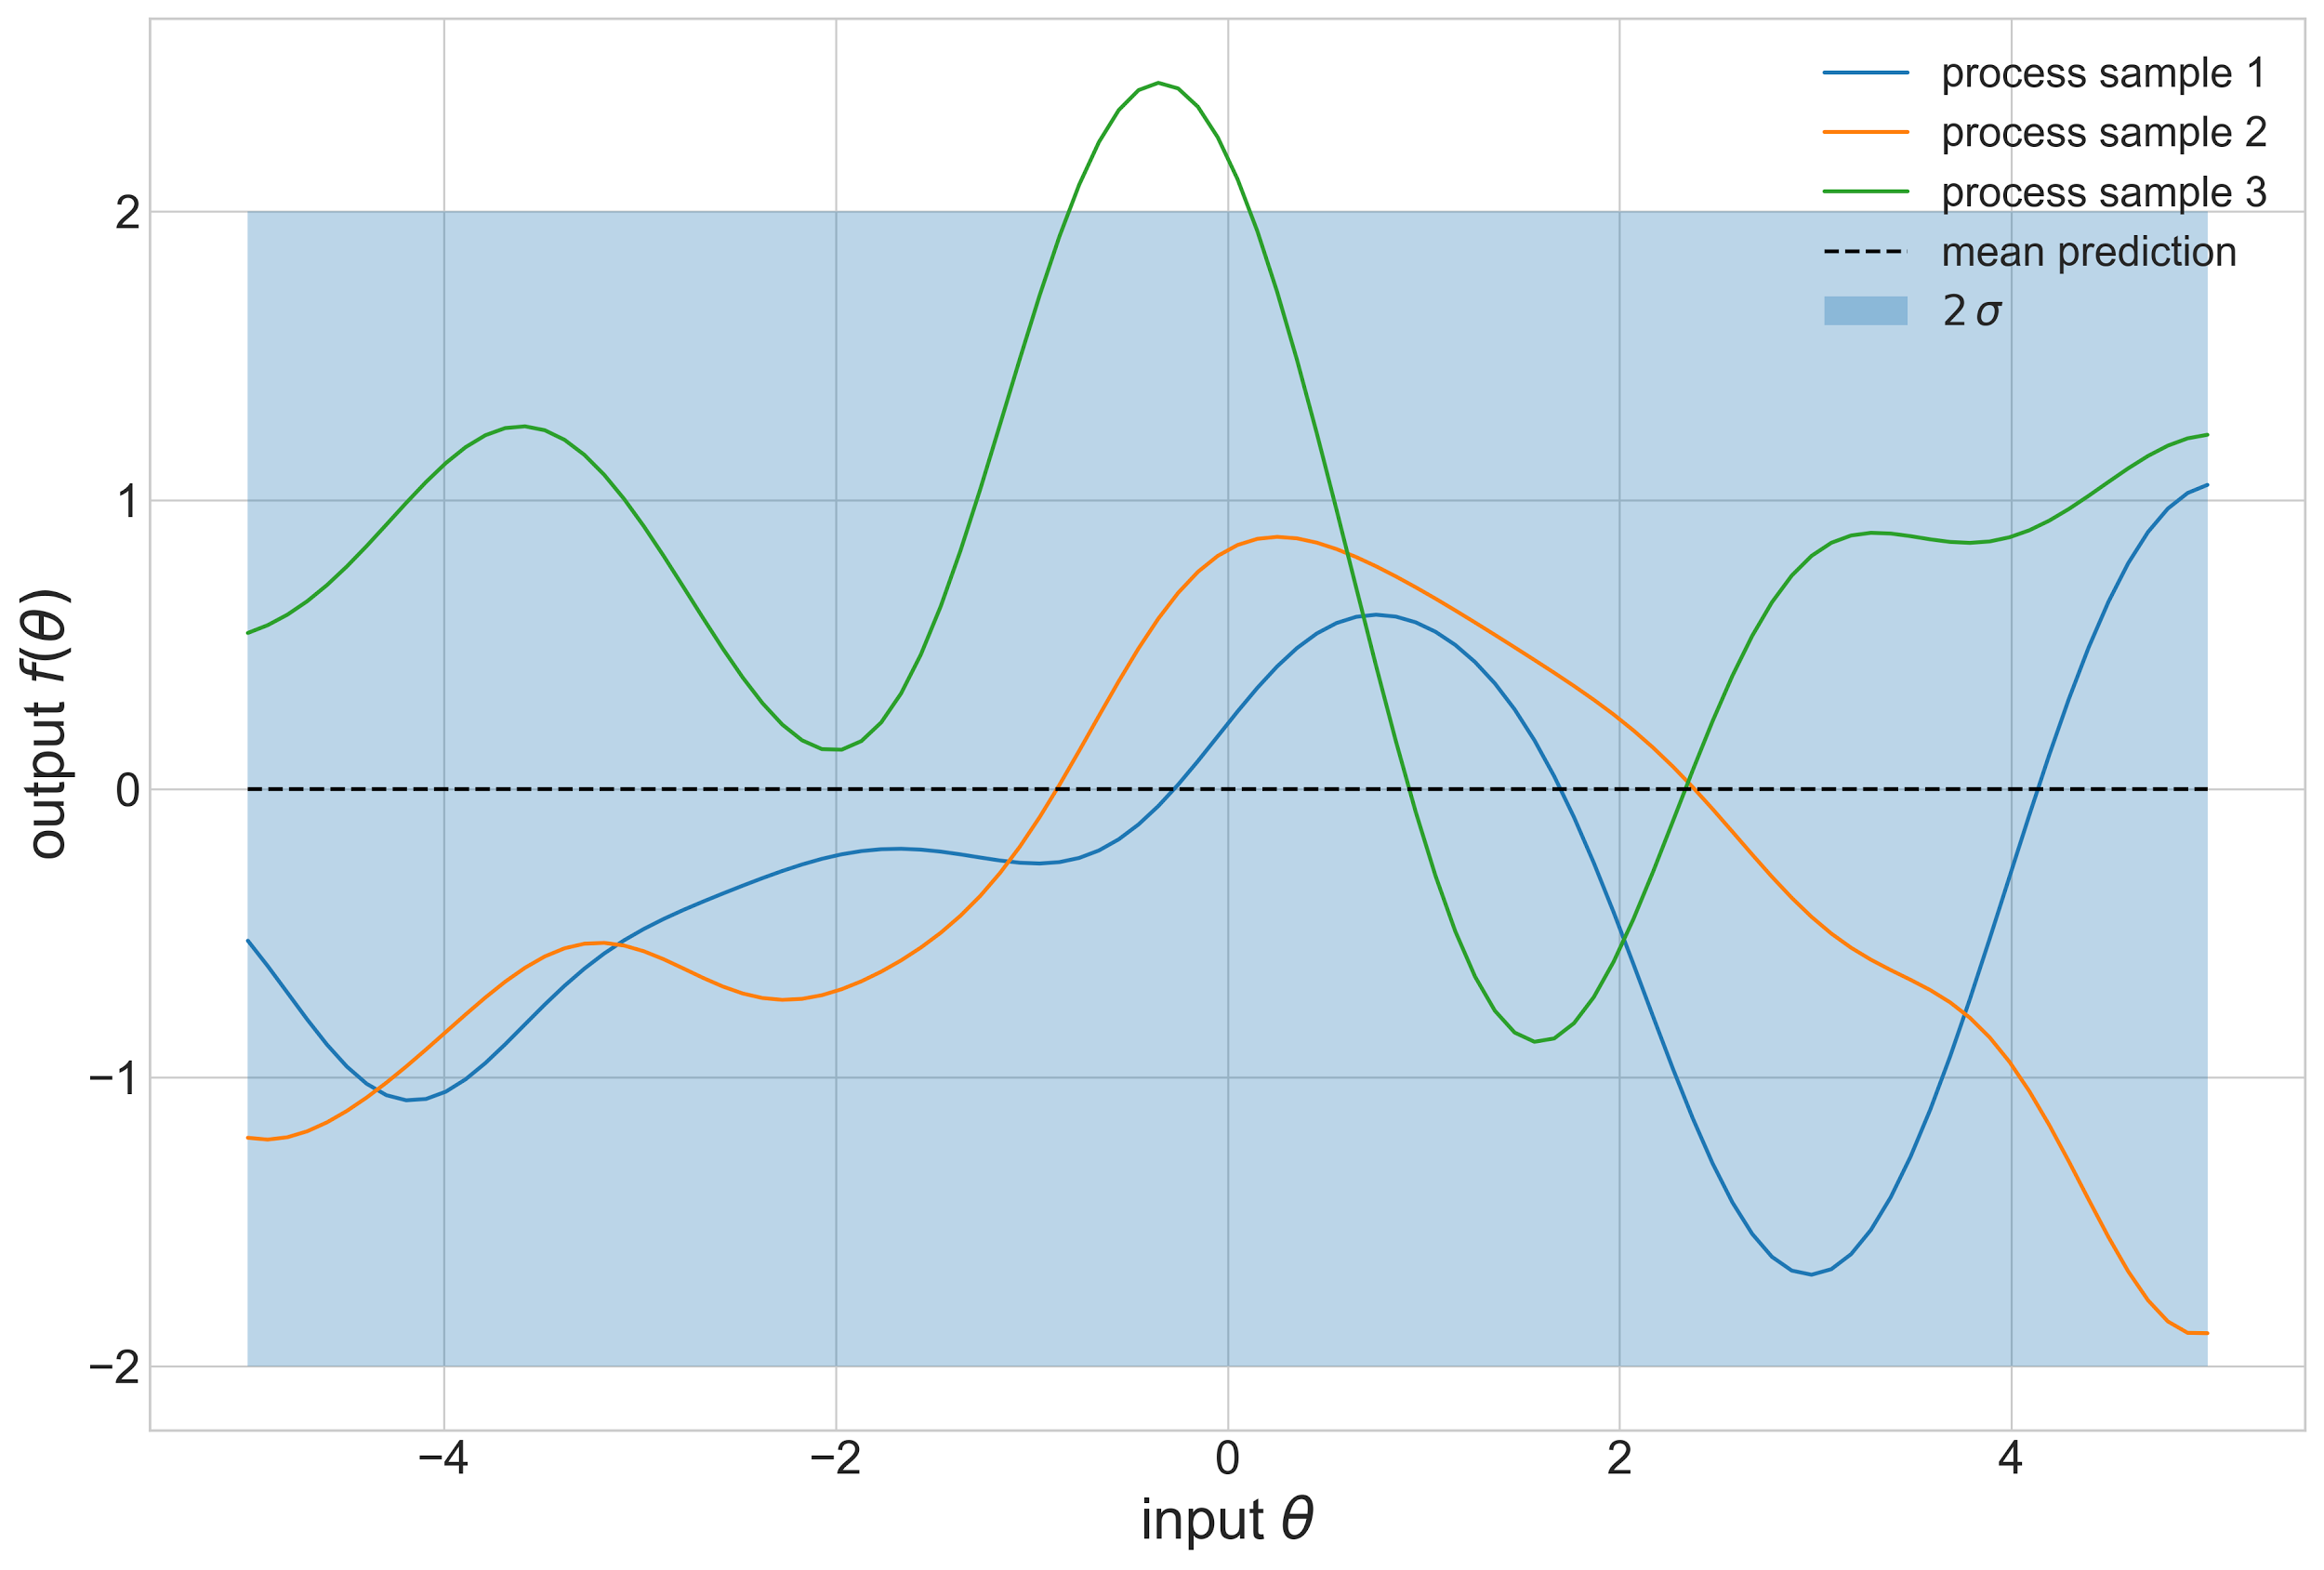
Bayesian Optimization
Assume objective function is Gaussian

Slide 26
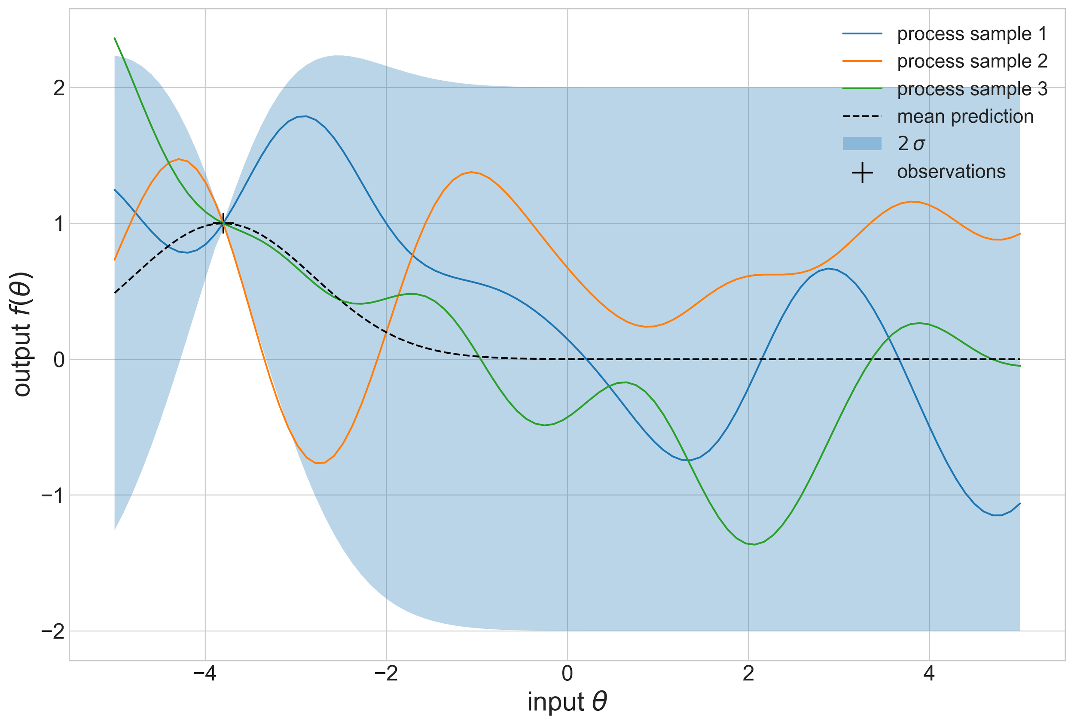
Bayesian Optimization
Assume objective function is Gaussian
Measure and update Prior

Slide 27
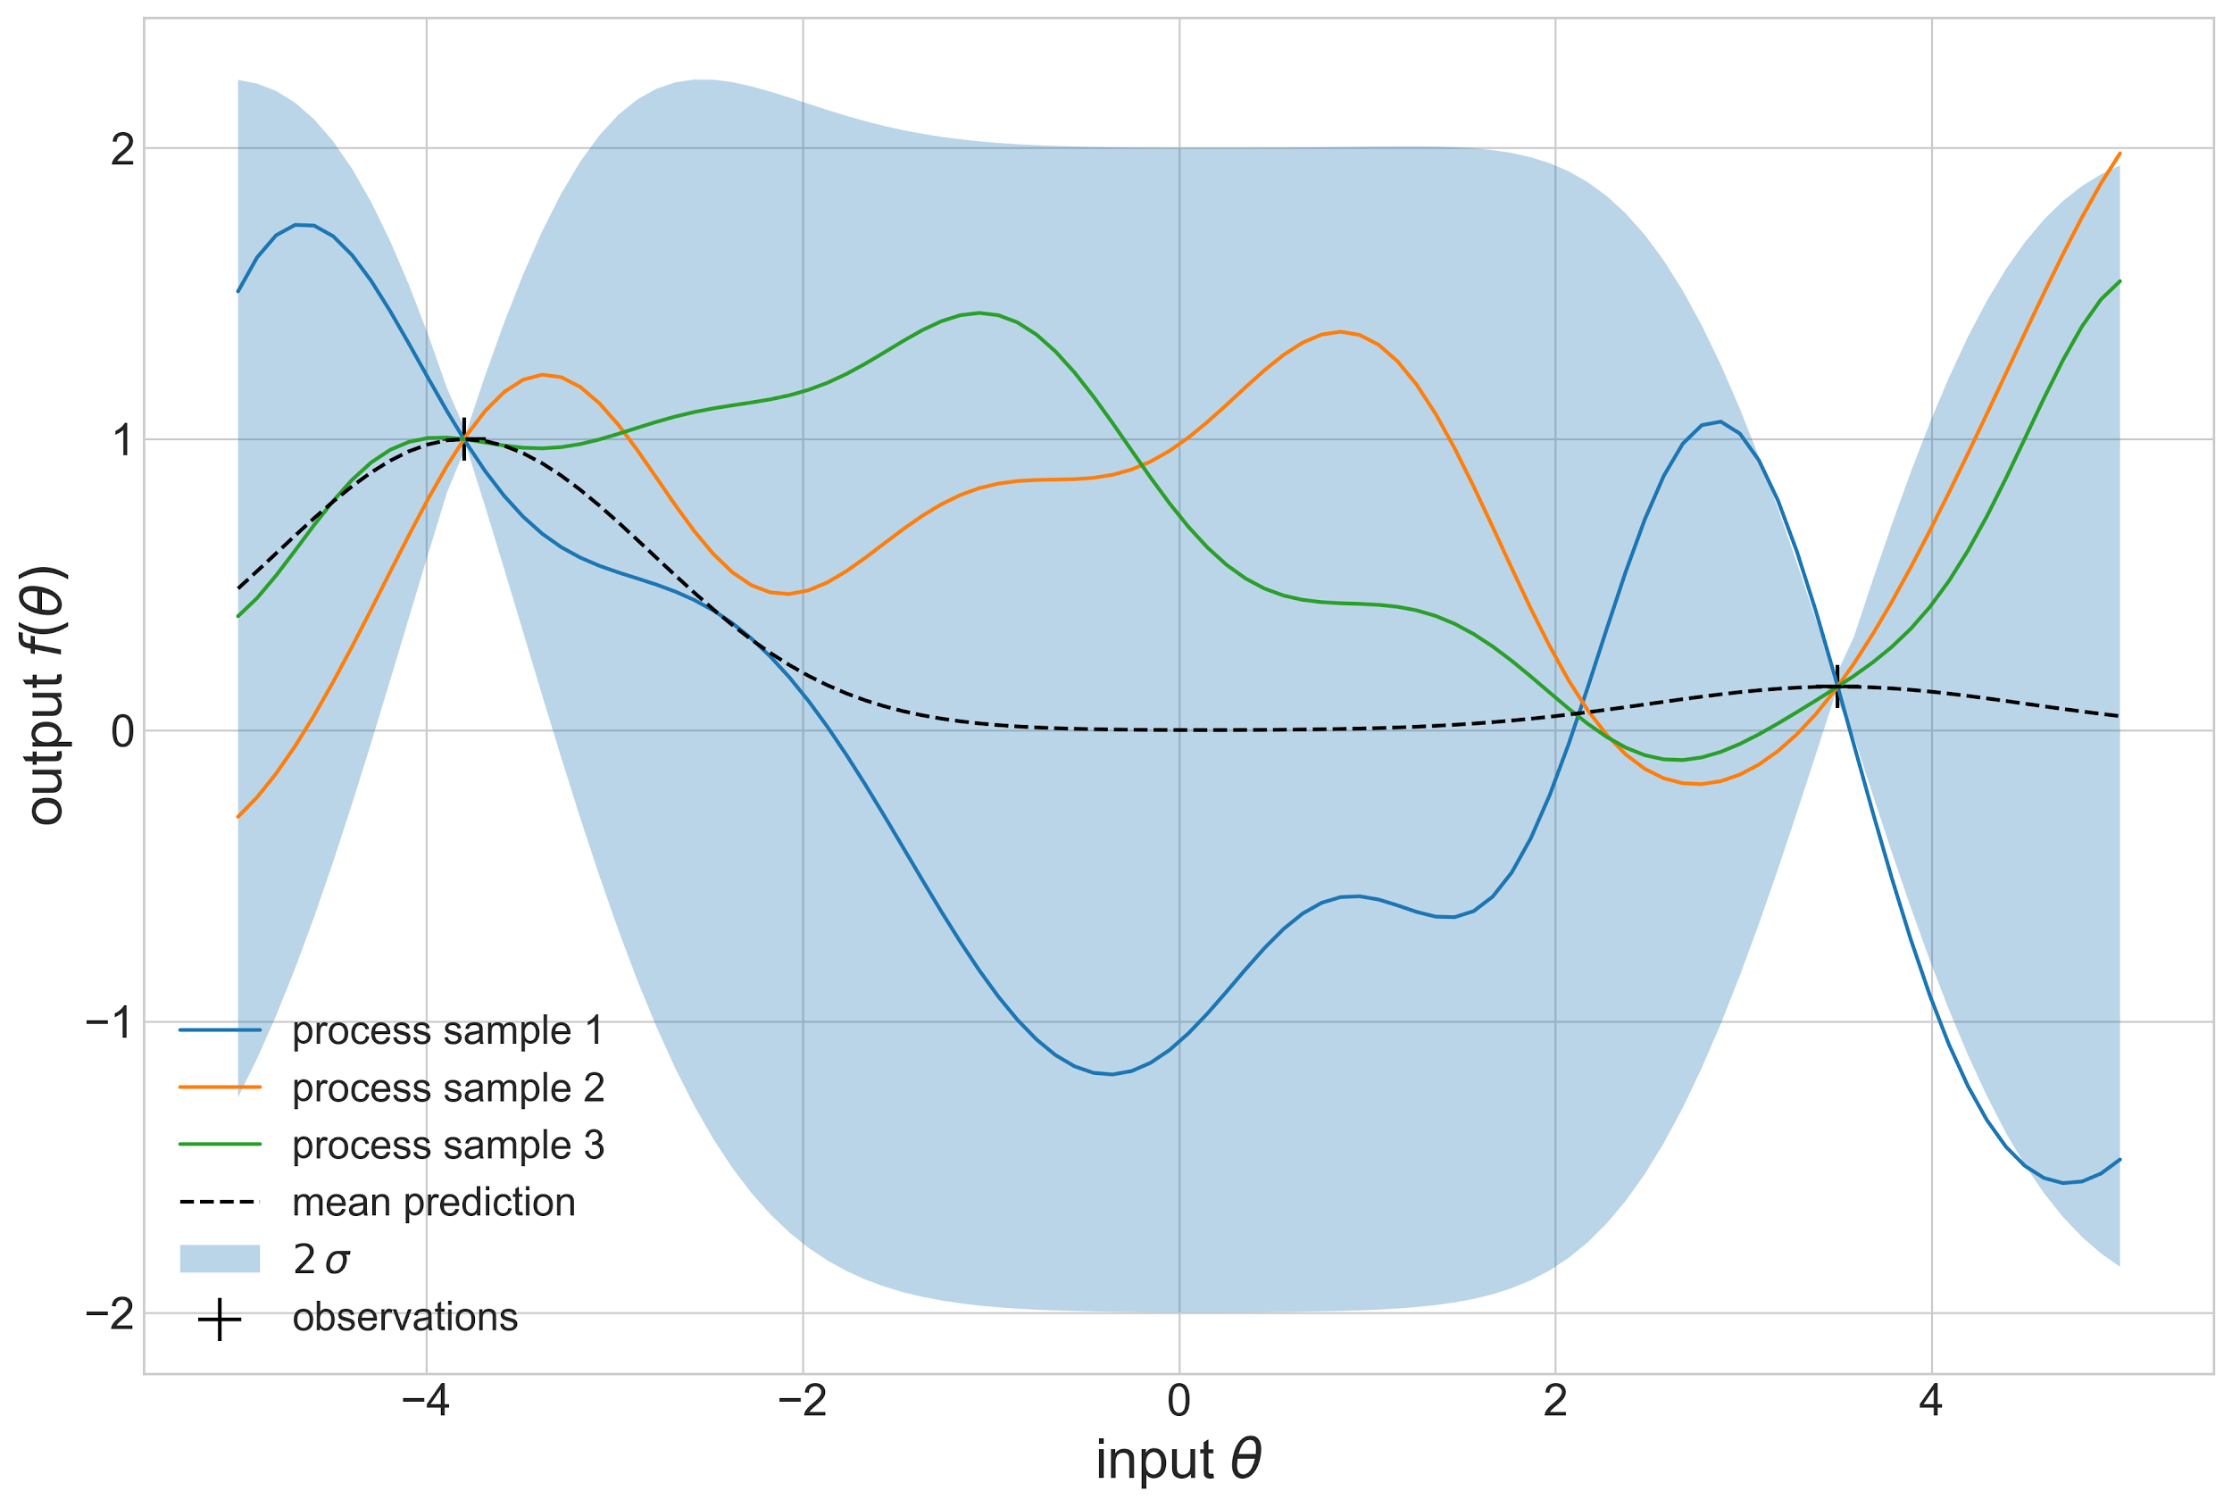
Bayesian Optimization
Assume objective function is Gaussian
Measure and update Prior
Choose next point to measure and update

Slide 28
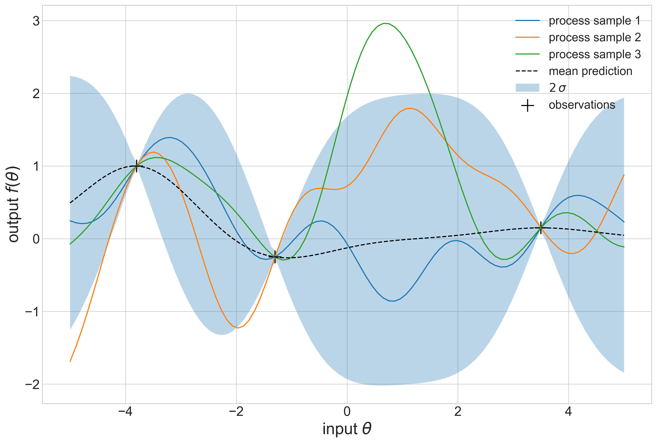
Bayesian Optimization
Assume objective function is Gaussian
Measure and update Prior
Choose next point to measure and update
Again

Slide 29
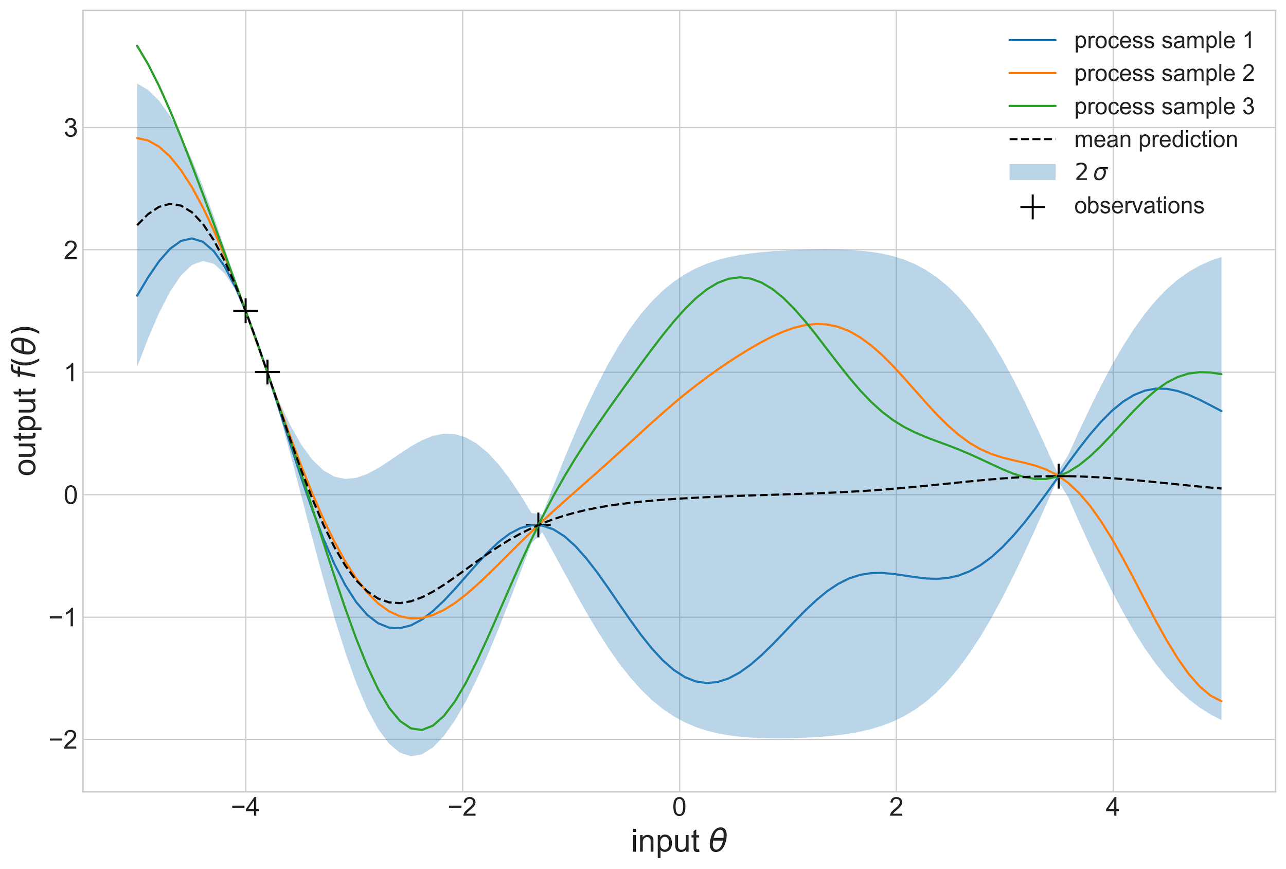
Bayesian Optimization
Assume objective function is Gaussian
Measure and update Prior
Choose next point to measure and update
Again
…

Slide 30
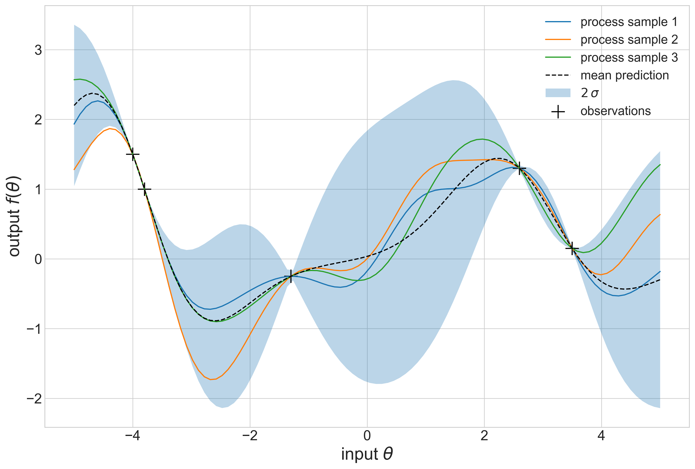
Bayesian Optimization
Assume objective function is Gaussian
Measure and update Prior
Choose next point to measure and update
Again
…
…

Slide 31
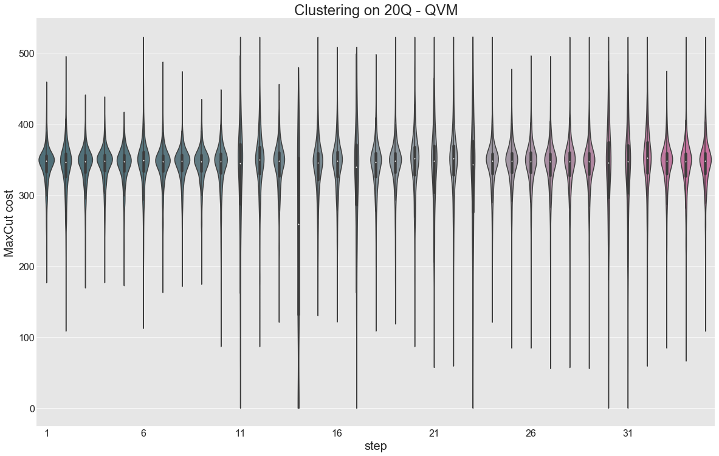
That’s how it looks in practice
At each step
Sample a new angle pair from the Gaussian prior
Run the Quil program and sample several bitstrings
Evaluate the MAXCUT cost and return maximum as the value
Update Prior and repeat the process

Slide 32
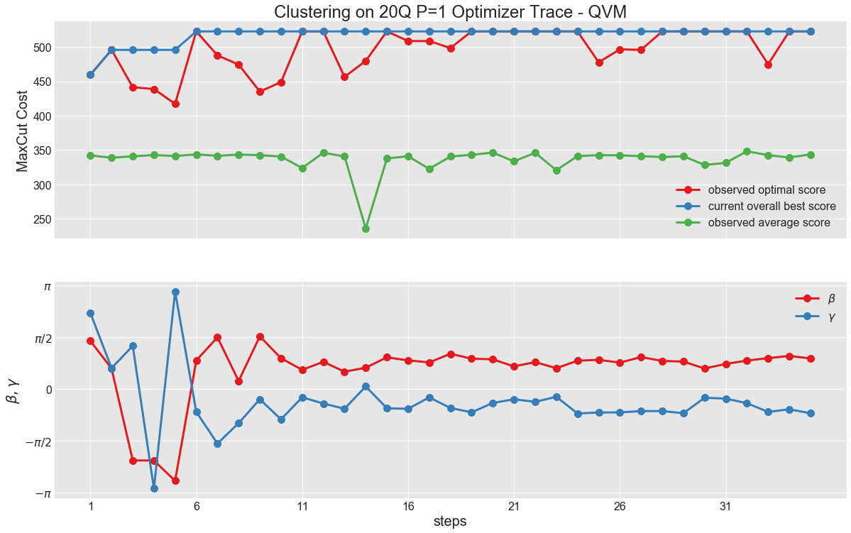
That’s how it looks in practice
At each step
Keep the historic best value
Angles start to converge for large steps numbers

Slide 33
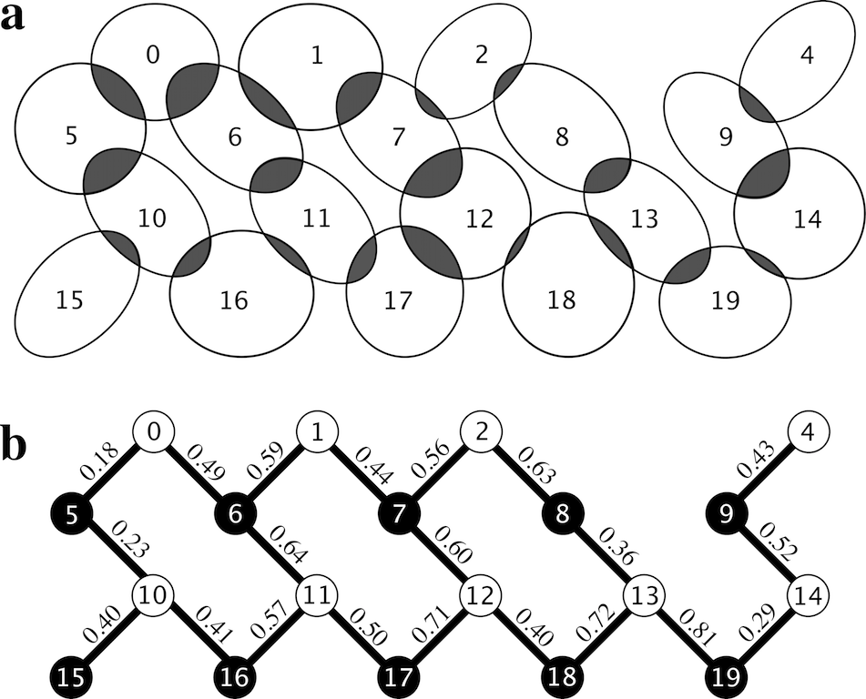
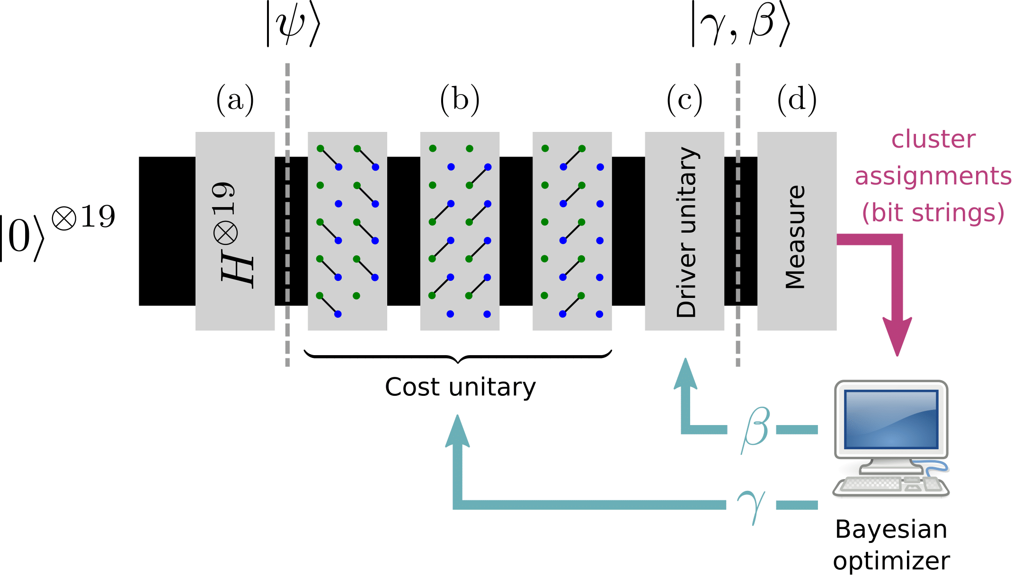
Clustering on a 19-Q Chip
For demonstration purposes chose problem instance to match chip topology

Slide 34
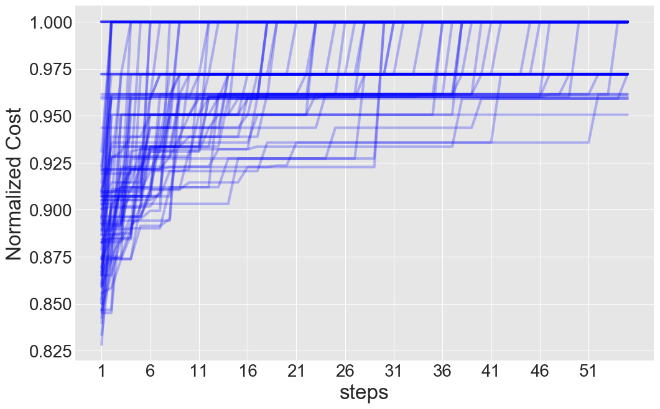
Putting it all together
83 trial runs on the QPU
Algorithm finds the optimum most of the time
Calculate success probability from the traces

Slide 35
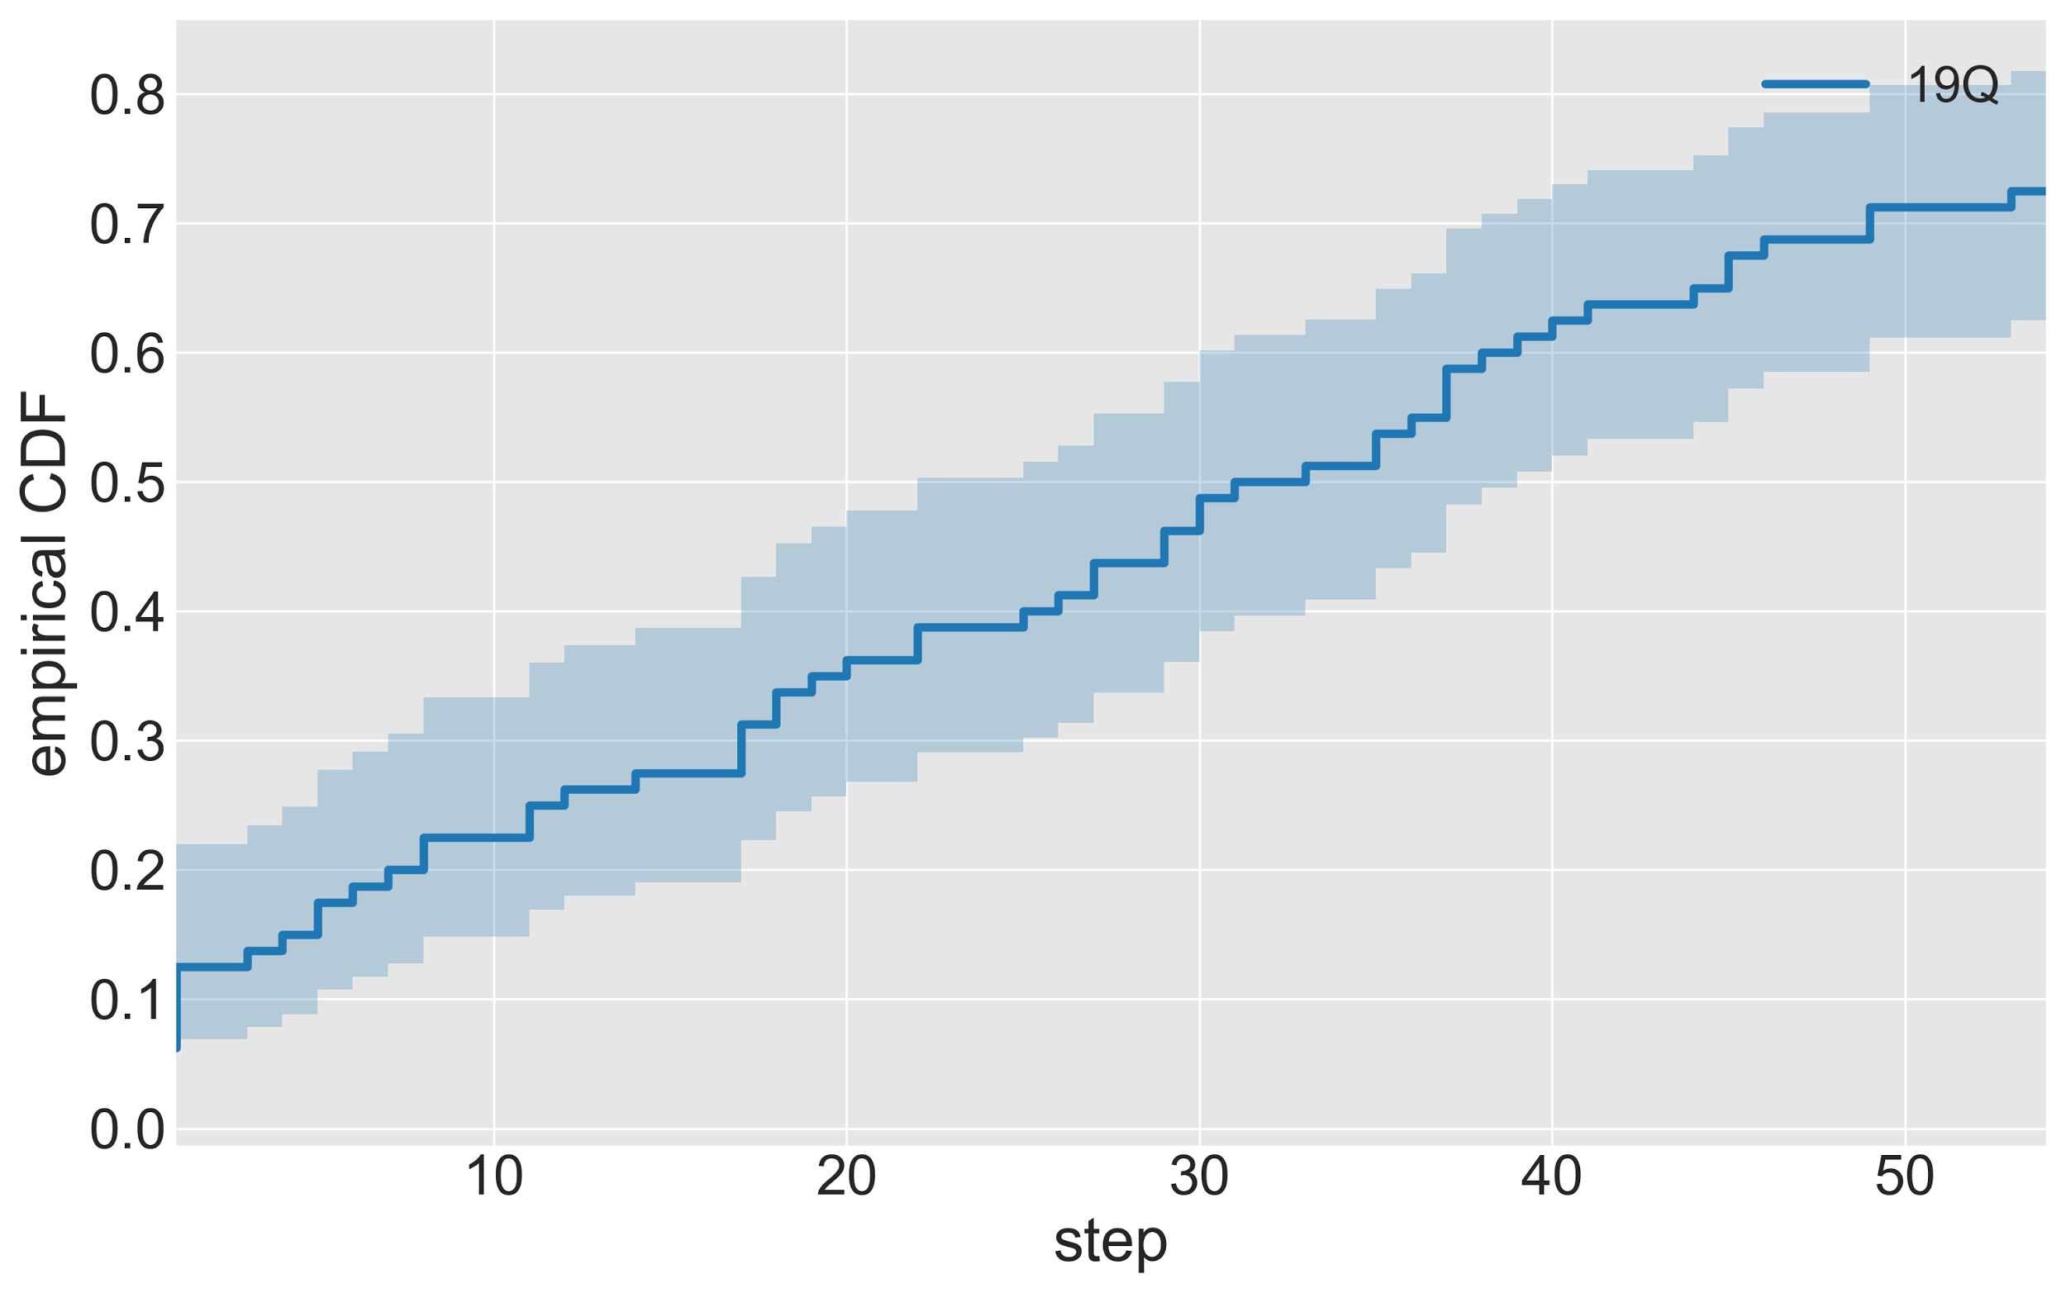
Empirical performance
Success probability monotonically increases with number of steps.

Slide 36
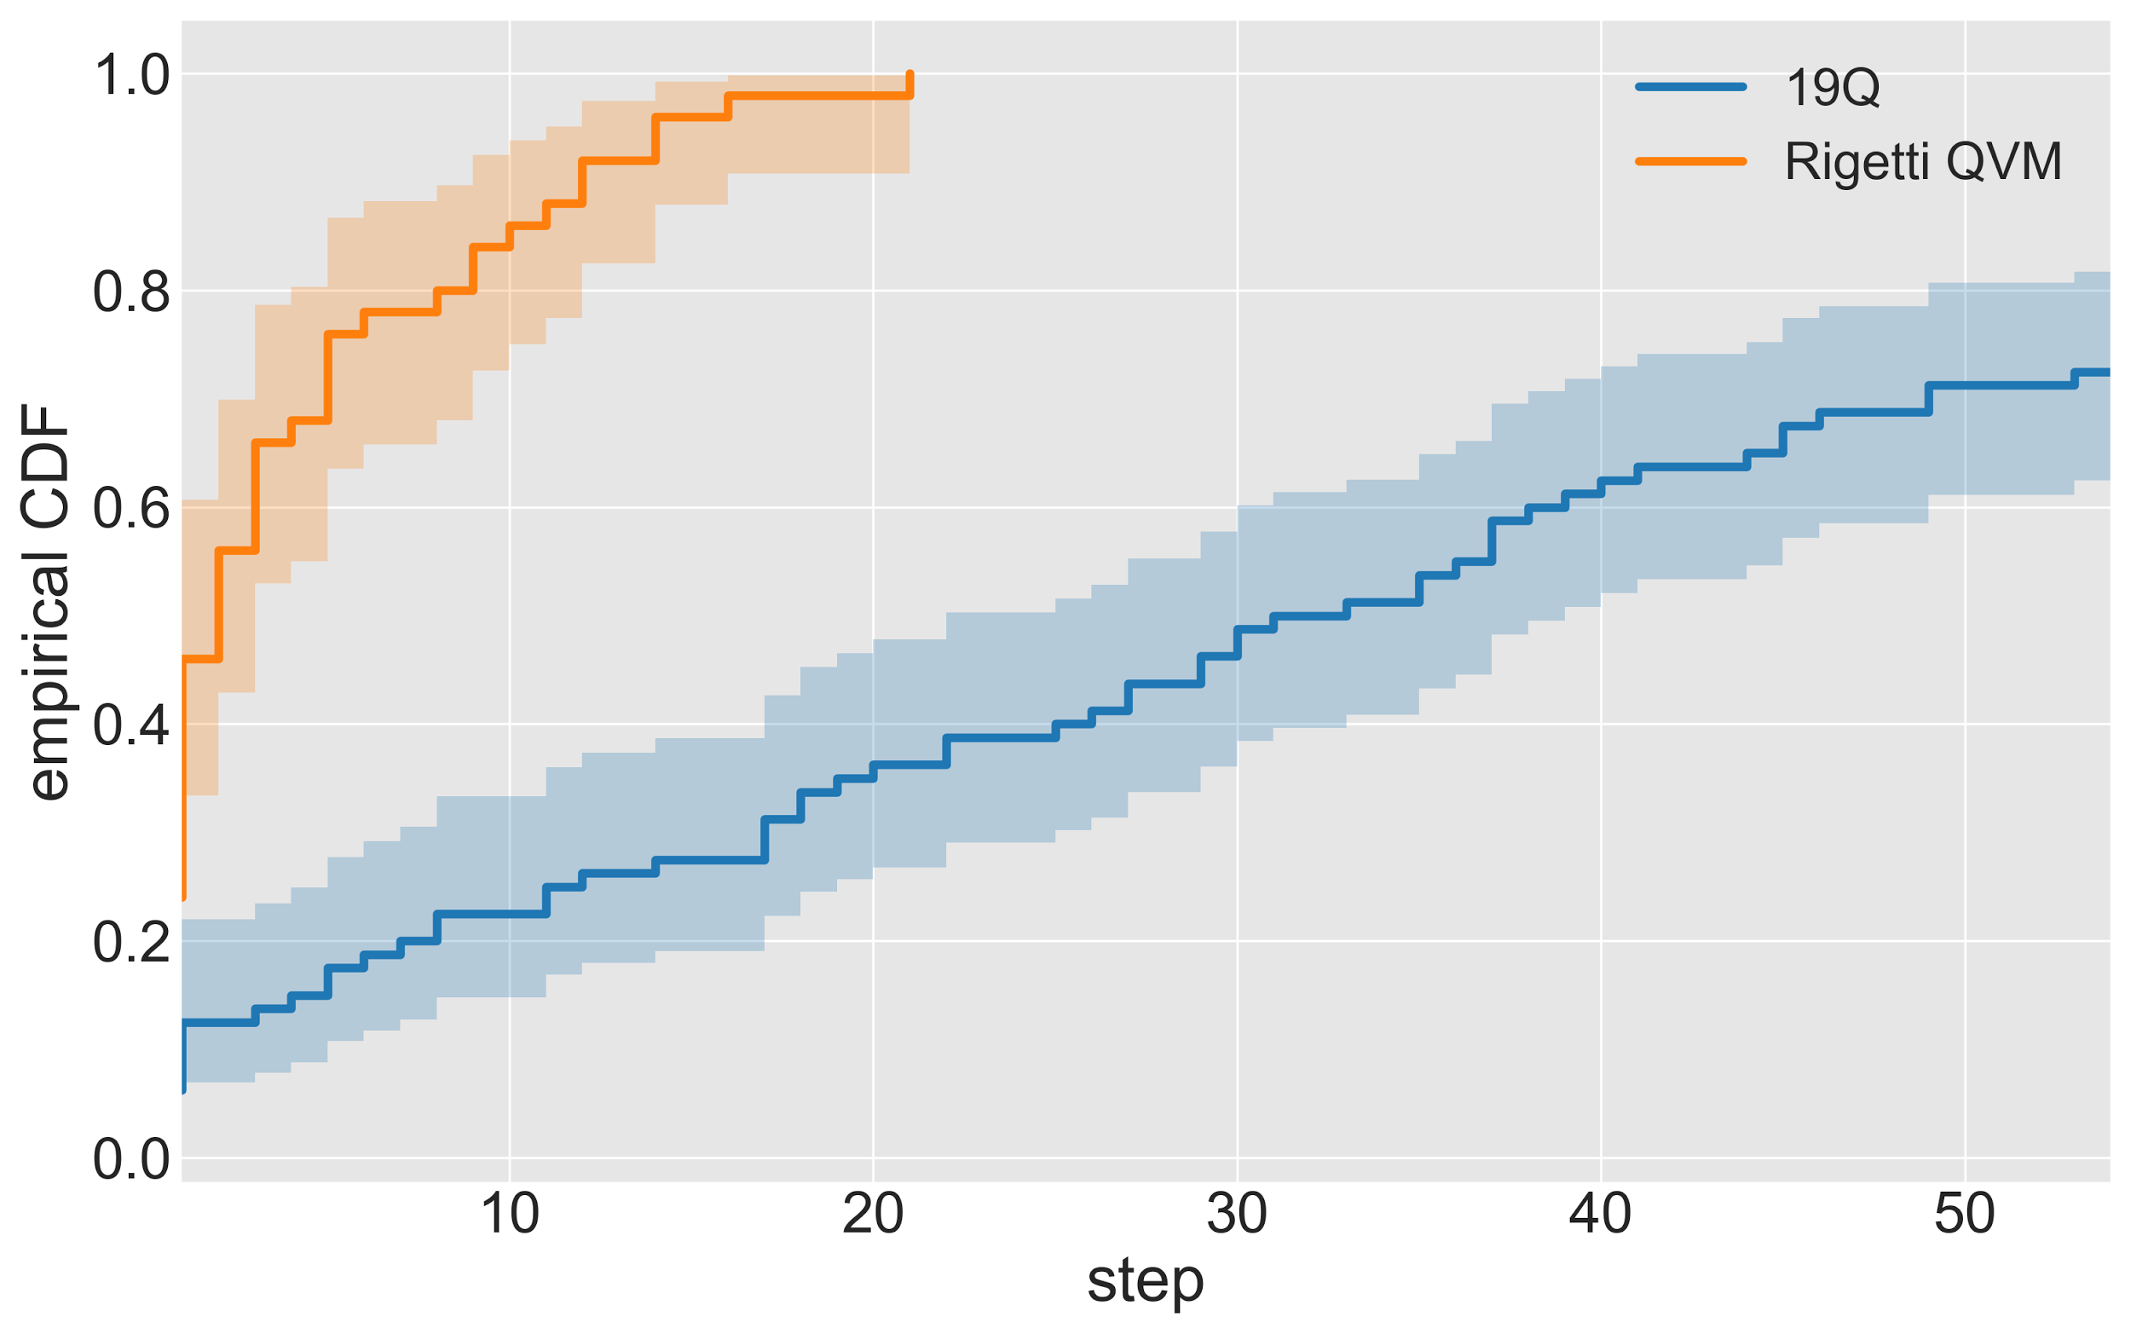
Empirical performance
Success probability monotonically increases with number of steps.
Noise in 19Q has a significant impact on performance.

Slide 37
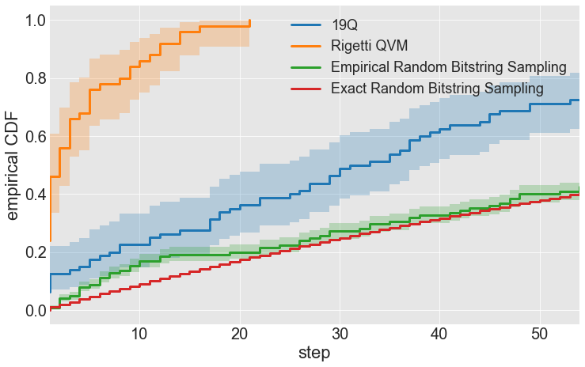
Empirical performance
Success probability monotonically increases with number of steps.
Noise in 19Q has a significant impact on performance.
Approach clearly outperforms random sampling.

Slide 38
Forest
Join our community Slack:
Find us on Github:
slack.rigetti.com
github.com/rigetticomputing
Sign-Up @ rigetti.com/forest QPU access @ rigetti.com/qpu-request

Slide 39
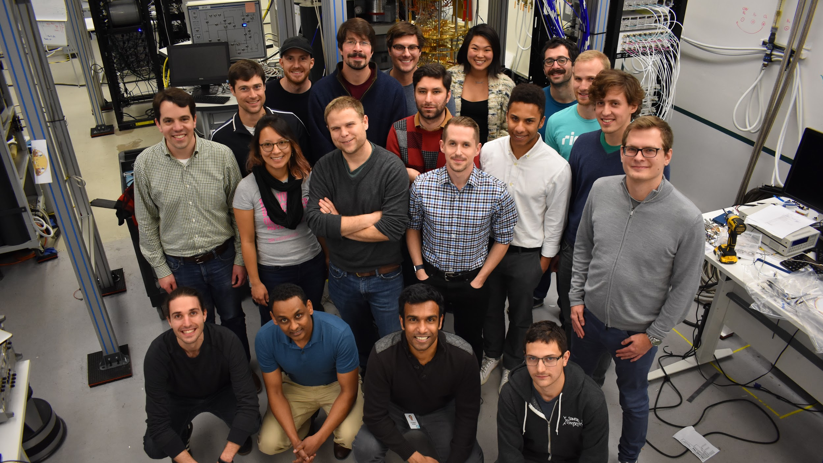
Thank you
More details in our pre-print arXiv: 1712.05771

Slide 40
Spare slides

Slide 41
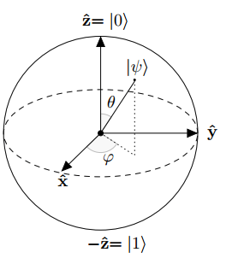
Bloch Sphere
Lives on the surface of the Bloch sphere

Slide 42
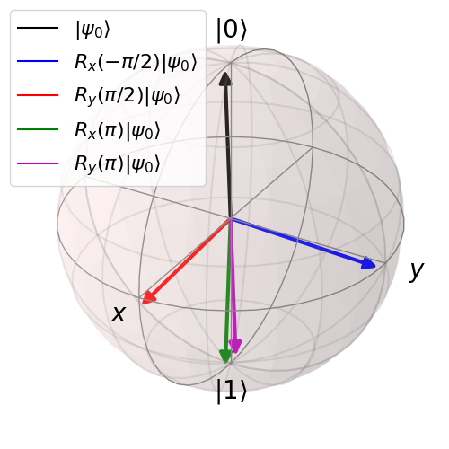
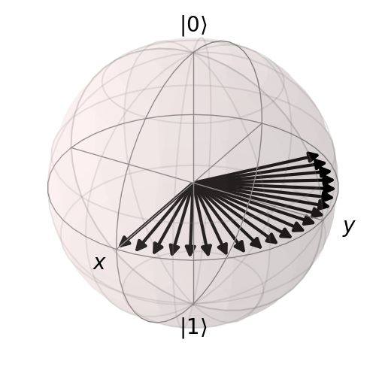
Quantum Control on the Bloch Sphere
“Machine that natively executes unitary operations on quantum systems”
Unitaries are rotations
X and Y rotations by driving
Z rotations by waiting

